Slide 1
Lumbar Spine Degenerative Classification BackProp for Back
Thursday, November 7, 2024
Presented by: Paul Schmelzer

Slide 2
Project goal and motivation
Goal: classify lumbar spine damages using MR images.
Motivation: Facilitate radiologist performance in diagnosing spine damages.
and
Notes:
my wife has got harniton in the spine.

Slide 3
Dataset
Dataset Origin from Kaggle: collected by RSNA (Radiological Society of North America)
The kind of damage: Classifying five lumbar spine degenerative conditions:
Left Neural Foraminal Narrowing
Right Neural Foraminal Narrowing
Left Subarticular Stenosis
Right Subarticular Stenosis
Spinal Canal Stenosis

Slide 4
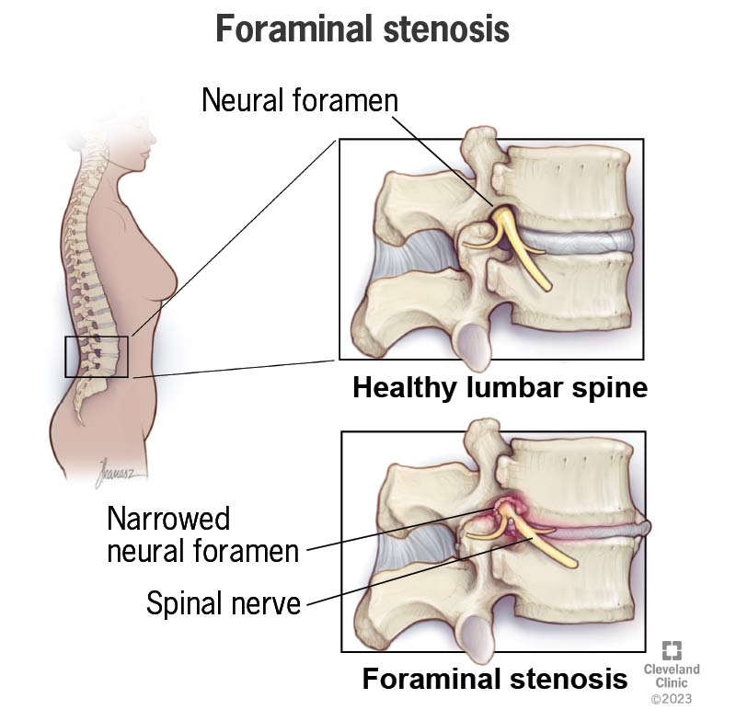
Neural Foraminal Narrowing : Narrowing of the nerve passageways in the spine (right and left)

Slide 5
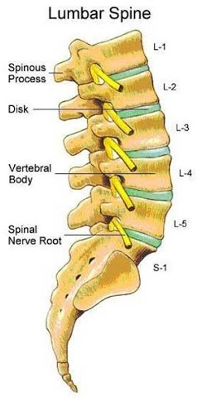
Dataset
Severity Levels: Normal/Mild, Moderate, Severe.
Disc Levels:
L1/L2 - L2/3 - L3/4 - L4/L5 - L5/S1
disc levels

Slide 6
Dataset
Research Focus:
Left Neural Foraminal Narrowing at L5/S1.
Reasoning: resource constraints
Five kind of damages and five levels: result in 25 rows
80 images pro person result in 2000 rows
A sample with 2000 persons results in 4 million rows

Slide 7
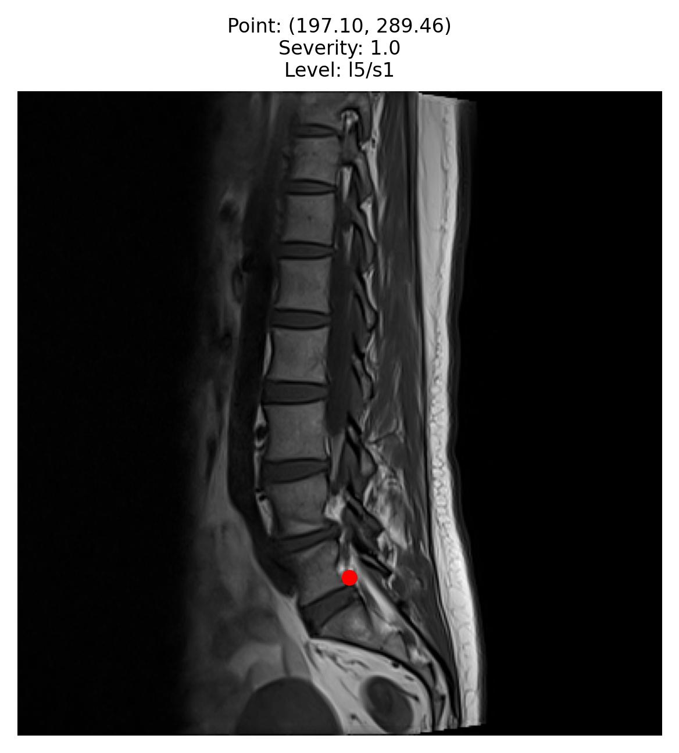
Dataset
Image Categories of MRI
Sagittal T1:
Sagittal T2:
Sagittal Images:
Show the entire spine,
Better for detecting neural foraminal narrowing.

Slide 8
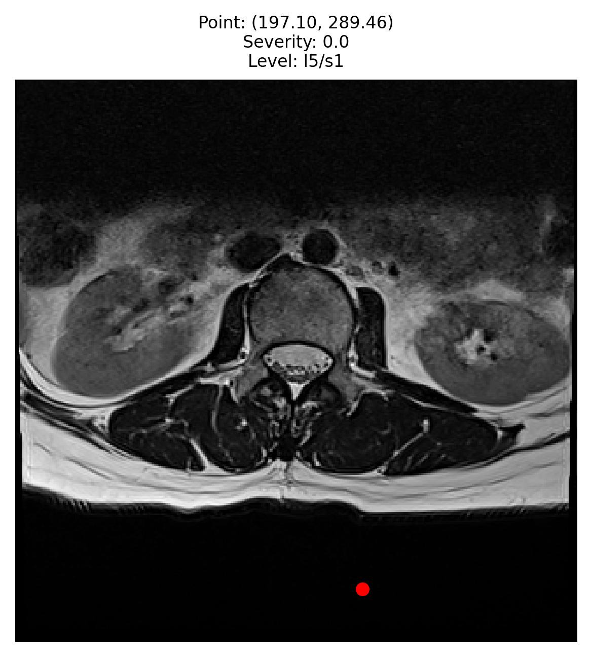
Dataset
Image Categories (stored in folders)
Axial T2
Axial Images:
Axial images show only a cross-sectional "slice" of the spine.
Keeping L5/S1 data few MR Axial images corresponding to L5/S1 "slice"

Slide 9
Dataset (sample for L5/S1)
Severity | Normal/mild | Moderate | Severe
N | 1247 | 520 | 206
Number of Persons:
Original sample has about 2000 persons
Average Images per Person:
Each individual has, on average, 30 images, totaling 60,000 rows.
Random Sampling Strategy:
A random sample of 4,000 images is selected for each severity category.
The sample is balanced by severity but not by person

Slide 10
Dataset (sample for L5/S1)
Train-test split 80% for training and 20% for testing.
Train validation split 80% for training and 20% for validation.
Calculation time on the training set is approximately one hour per epoch (5 hours).

Slide 11
Dataset
Predictions: on test data for Left Neural Foraminal Narrowing L5/S1
Predictions: on other positions L1/L2 - L2/3 - L3/4 - L4/L5 and
Predictions: How well it performs on Right Neural Foraminal Narrowing ?

Slide 12
Methods - Transfer Learning with Pretrained ResNet-50 for Feature Extraction
ResNet-50
A deep convolutional neural network with 50 layers
Tackles the vanishing gradient problem in deep networks
Ideal for deep learning on complex, layered datasets
Operates with pre-trained weights
ImageNet-1k contains 1,000 categories and millions of images
Good choice for medical imaging, image recognition
Introducing of additional layers to improve performance of the original model
Notes:
ResNet-50 is designed to overcome the vanishing gradient problem in deep neural networks. It achieves this through residual learning, where the network learns the differences (residuals) between the input and the output instead of attempting to learn the full mapping. This is implemented using shortcut connections, allowing gradients to flow directly through the network's layers during backpropagation, ensuring effective training even in very deep architectures

Slide 13
Methods - Transfer Learning with Pretrained Model ResNet-50
Early stopping
Divergence-Based Early Stopping:
Validation loss exceeds training loss by more than a predefined threshold (0.5)
Over a certain number of epochs (5)
Plateau-Based Early Stopping:
Validation loss stops improving for a specified number (5) of epochs
Notes:
ResNet-50 is designed to overcome the vanishing gradient problem in deep neural networks. It achieves this through residual learning, where the network learns the differences (residuals) between the input and the output instead of attempting to learn the full mapping. This is implemented using shortcut connections, allowing gradients to flow directly through the network's layers during backpropagation, ensuring effective training even in very deep architectures

Slide 14
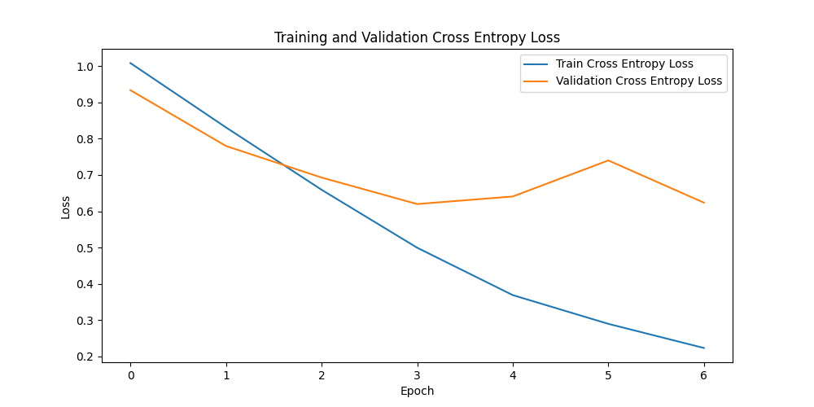

Slide 15
Accuracy
Baseline Accuracy = Count of Majority Class Samples/​ Total Number of Samples
Base line accuracy 35%
End Accuray about 85%

Slide 16
Results: prediction on L5/S1 left Left Neural Foraminal Narrowing
 | Prediction normal | Probability medium | Probability severe
 | 0.33 | 0.33 | 0.33
Normal | 83 | 115 | 2
Medium | 10 | 88 | 10
Severe 2 | 2 | 15 | 96

Slide 17
Results: predicion on L1/L2 - L2/3 - L3/4 - L4/L5 (left and right side)
Moderate

Slide 18
Preliminary Results
After getting domain knowledge
Strategy
Taking axial MRI for predicting spinal damages:
Cases with medium + severe vs. normal severity
ity
Nmal/mild
Sampling
Cases with medium and severe severity are undersampled in terms of persons, but balanced in terms of images.
For each person, there are 7000 images (7000 x 2 = 14000)
Train-test split 80% for training and 20% for testing.
Train validation split 80% for training and 20% for testing.
Moderate

Slide 19
Next steps
Nice to have:
Localization of the L5/S1 vertebrae in spinal MRI images of the lumbar spine.
This allows for loading MRI images of the spine and assigning x and y coordinates for predictions.
Moderate

Slide 20
Early stopping

